Slide 1
Hud homeless rate prediction

Slide 2
Overview
Introduction
The Data
Analysis
Results
Conclusion

Slide 3
Introduction
The U.S. Department of Housing and Urban Development (HUD) argues that local market factors are determinants and factors in homelessness.
Can we create a model that better fits then the HUD model?

Slide 4
Data
The data is from HUD.
Additional data is included about the federal state funding
How did we clean the data?
Removed missing data
Did a quality check
Converting data

Slide 5
Analysis Overview
Ridge Regression: approach finds the parameters in the linear model by minimizing a penalized squared error with the magnitude of the coefficient
Lasso Regression: type of regression finds the parameters in the linear model by minimizing a penalized squared error with the square of the coefficent
XGBoost: Use cross-validation to find the best parameters for an XGBoost model.

Slide 6
Results

Slide 7
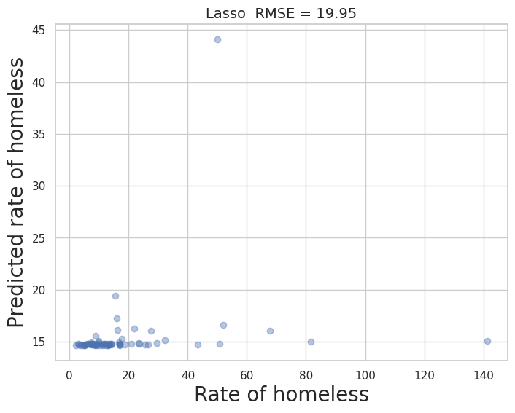
Lasso Regression
The model is somewhat accurate. There are a few outliers that make it hard to determine the accuracy of the model.

Slide 8
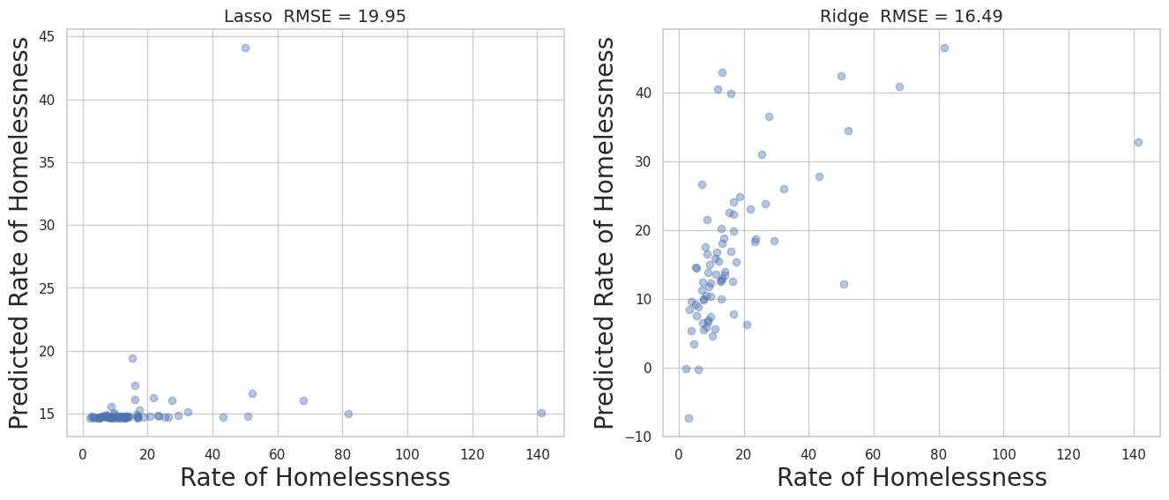
Comparing the Lasso and Ridge Graphs
The ridge regression is a better prediction model than the lasso model.

Slide 9
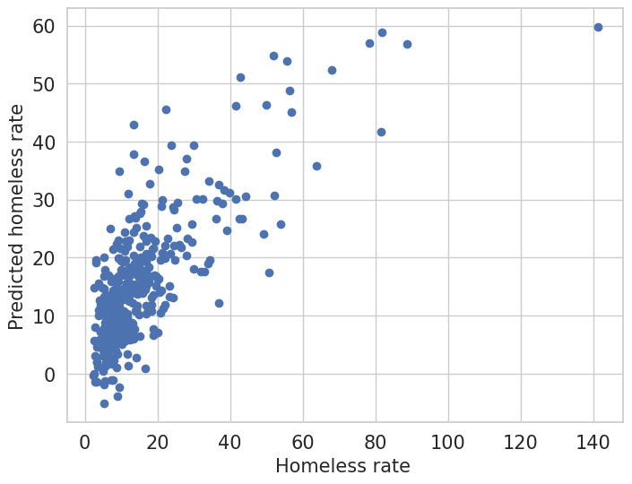
XGboost Regression
The model has a fairly accurate prediction rate of homelessness to the actual rate of homelessness.

Slide 10
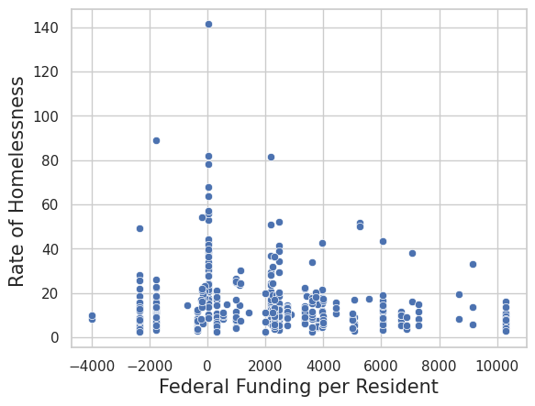
Additional Step
There was no strong correlation between federal funding and the rate of homeless.

Slide 11
Conclusion
The three types of regression that we made all have somewhat accurate models but they are not perfect.
There was no strong correlation found between the state federal funding and the rate of homelessness.

Slide 12
Questions?

